Slide 1
Pune District Education Association’s PROF. RAMKRISHNA MORE ARTS, COMMERS & SCIENCEVCOLLEGE Pradhikaran , Akurdi , Pune – 411044 (Maharashtra) India.
NAME :- OM DNYANESHWAR WALUNJ
SUBJECT :- MINI PROJECT
ROLL NO :- 126
DEPARTMENT :- B.VOC{SOFTWARE DEVELOPMENT}
(FIRST YEAR)
SUBJECT :- STATIC WEB DESIGN
TOPIC :- PORTFOLLIO PHOTOGRAPHER

Slide 2
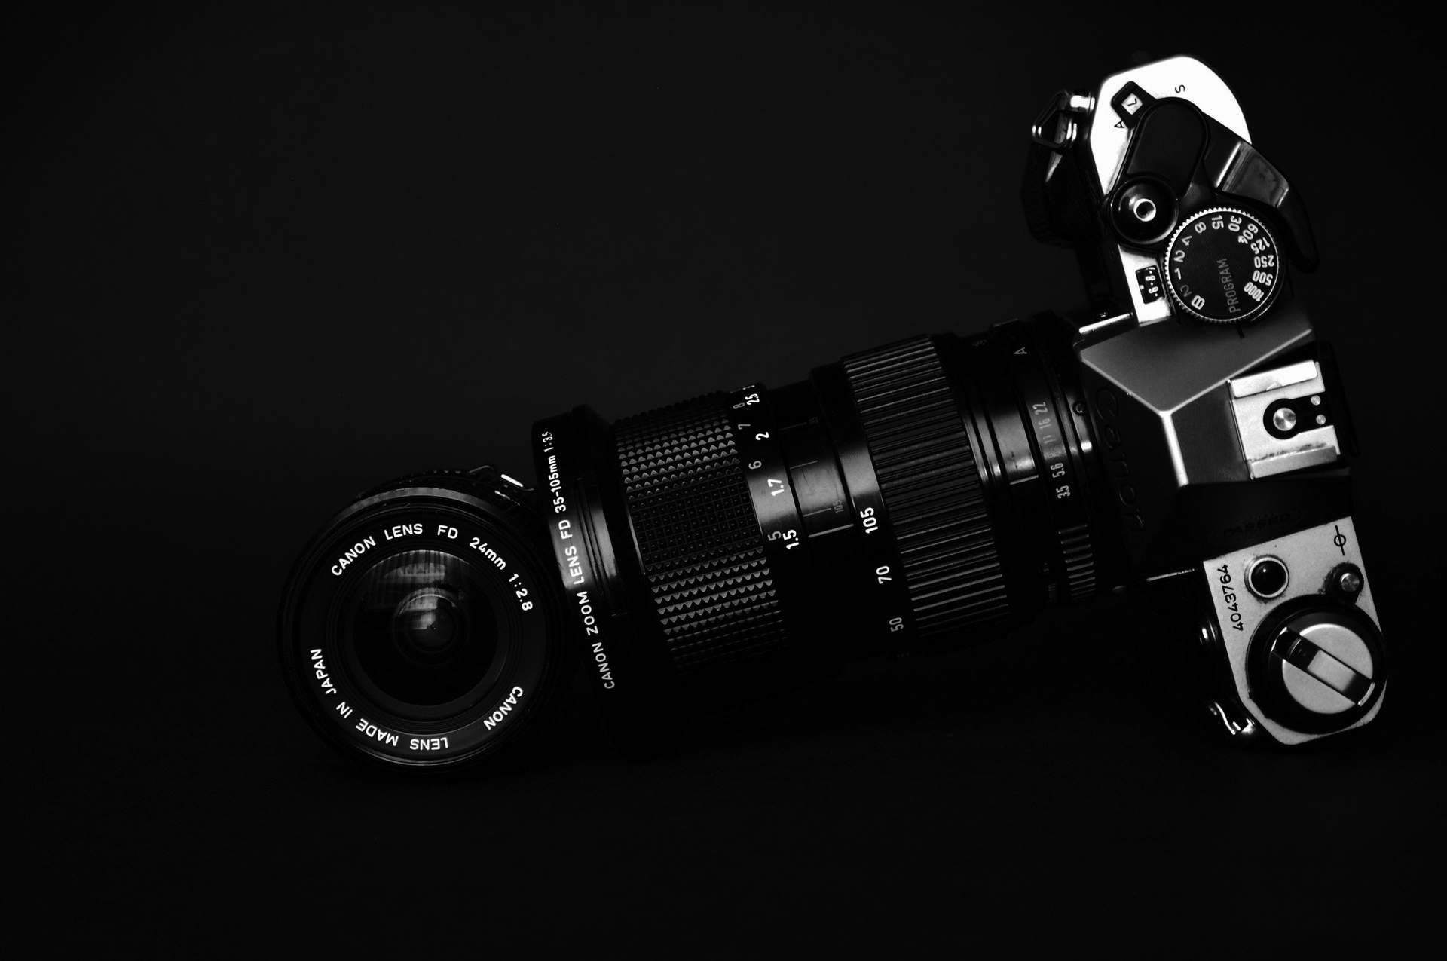
PORTFOLIO PHOTOGRAPHER

Slide 3
INDEX
INTRODUCTION
OBJECTIVE AND SCOPE OF PROJECT
DETAILS OF HARDWARE AND SOFTWARE USED
INPUT AND OUTPUT DESING

Slide 4
INTRODUCTION
I’M [OM WALUNJ], A PHOTOGRAPHER PASSIONATE ABOUT CAPTURING MOMENTS THAT TELL A STORY. SPECILIZING IN [PORTRAITURE, LANDSCAPES, EVENTS, FAMILYS, ETC.], MY WORK IS ALL ABOUT FINDING BEAUTY IN THE DETAILS AND EMOTIONS THAT MAKE EACH MOVEMENT UNICE. TAKE A LOOK THROUGH MY PORTFOLIO, AND FEEL FREE TO REACH OUT IF YOU’D LIKE TO COLLABORATE!

Slide 5
SCOPE OF PROJECT
Scope of Project :
Range of Genres: A collection of work across multiple photography disciplines, such as portraiture, landscape, product, and event photography.
Variety of Techniques: Examples of different shooting styles, from candid and documentary to carefully posed and conceptual shots.
Post-Processing and Editing: Showcasing my skills in editing and retouching, with attention to detail in color correction and image enhancement.
Client Collaboration: Work that demonstrates my ability to collaborate with clients to bring their vision to life, reflecting their brand or personal aesthetic.

Slide 6
OBJECTIVE OF PROJECT
OBJECTIVE : Showcase my versatility across different photography genres (e.g., portraits, events, landscapes, commercial).Demonstrate my ability to capture emotion and tell stories through imagery.Highlight my proficiency in both natural and studio lighting techniques.Provide potential clients with a clear sense of my style and approach to photography.

Slide 7


DETAILS OF HARDWARE AND SOFTWARE USED

Slide 8
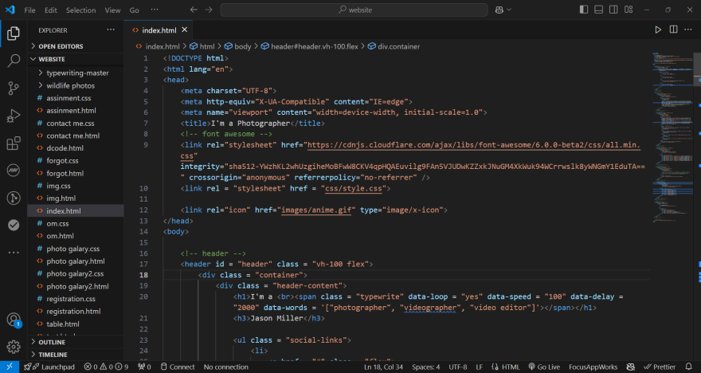
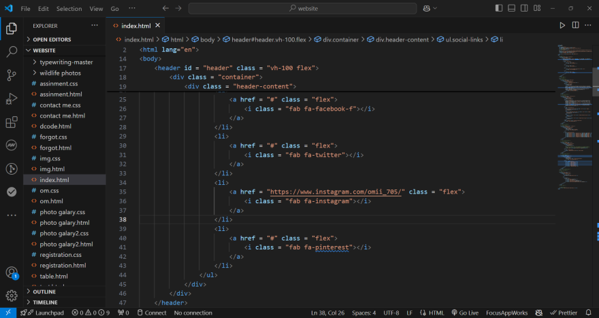
INPUT AND OUTPUT DESINE

Slide 9
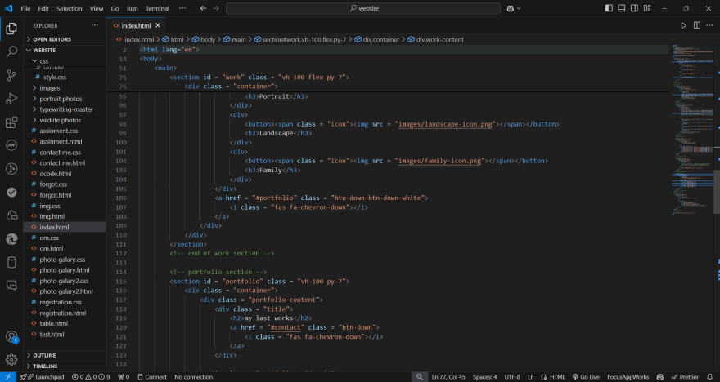
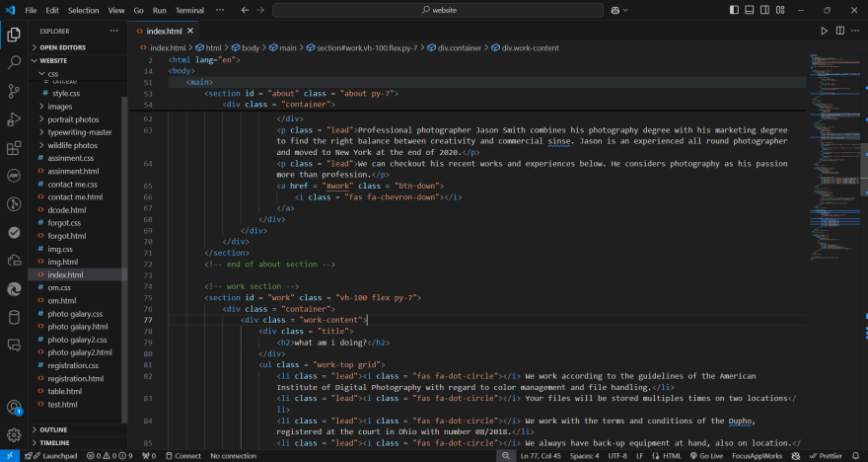
INPUT AND OUTPUT DESINE

Slide 10
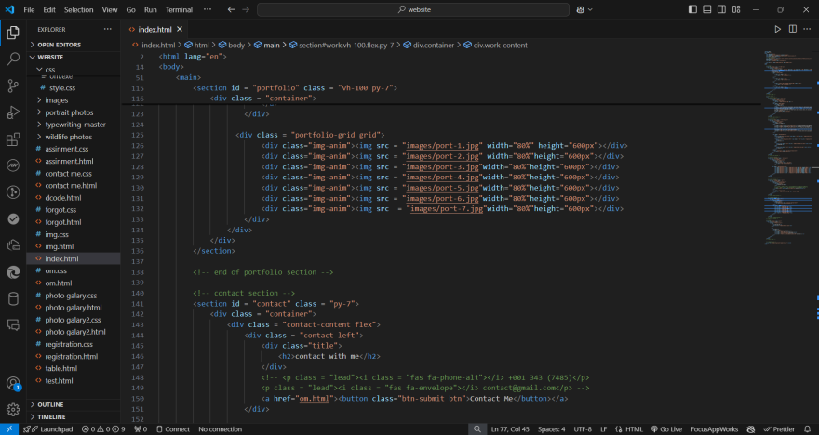
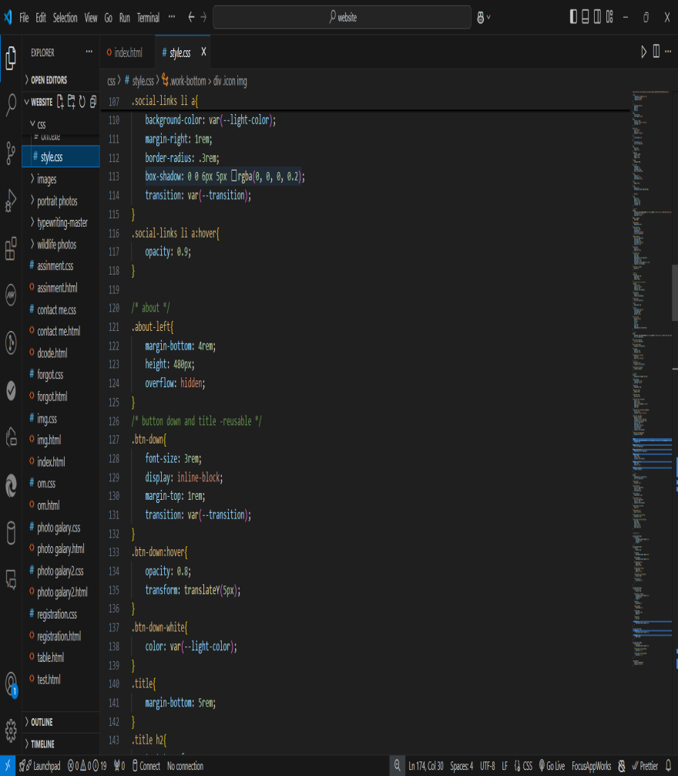
INPUT AND OUTPUT DESINE

Slide 11
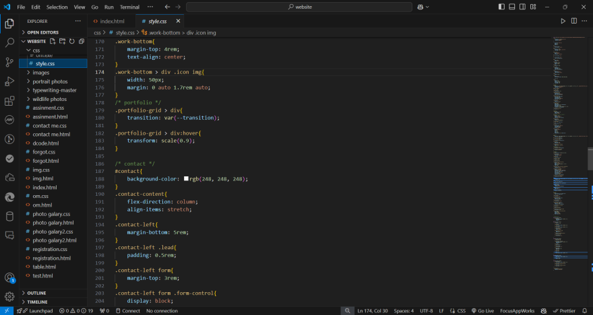
INPUT AND OUTPUT DESINE

Slide 12
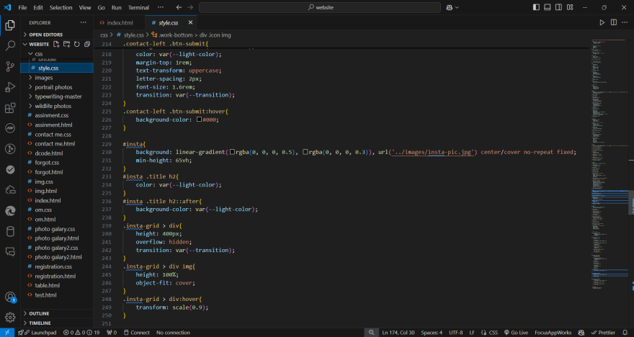
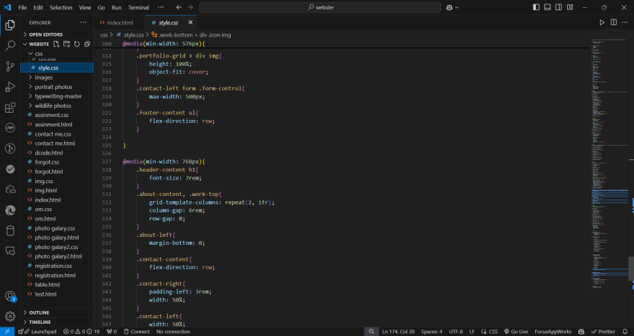
INPUT AND OUTPUT DESINE

Slide 13
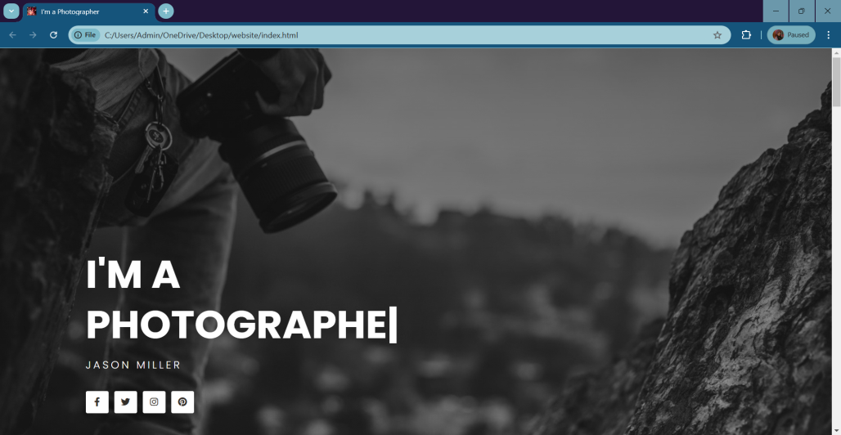
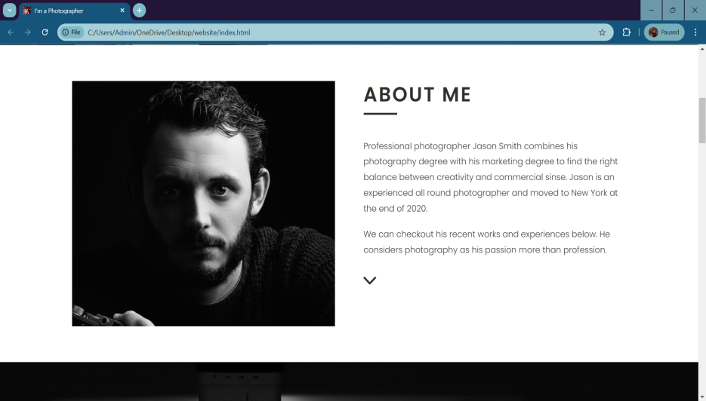
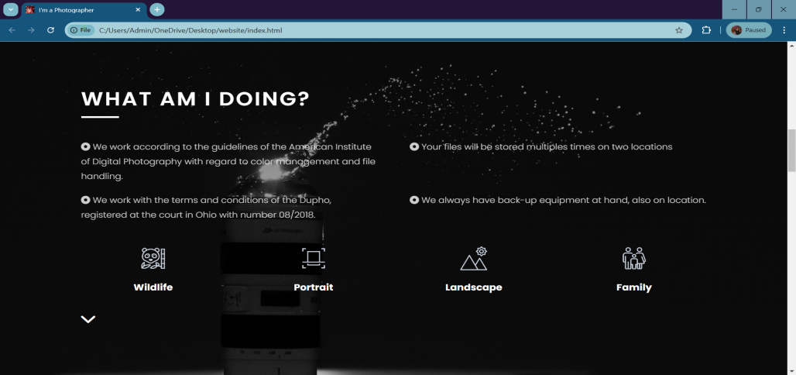
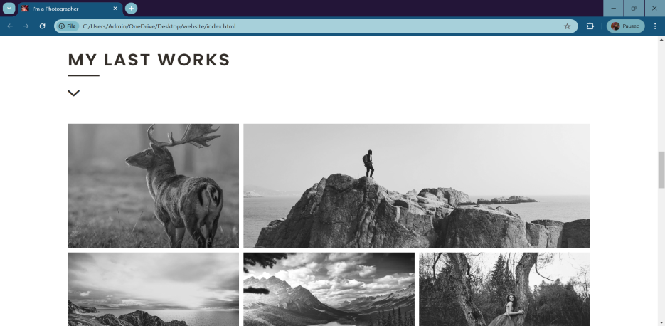
INPUT AND OUTPUT DESINE

Slide 14
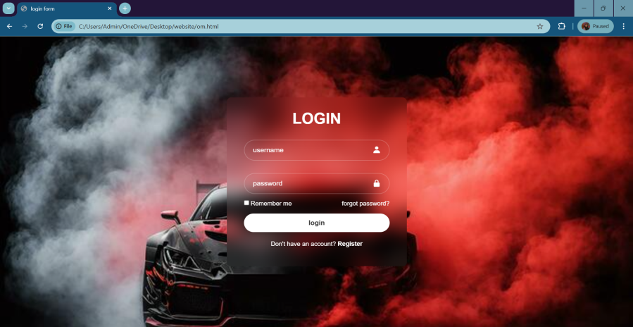
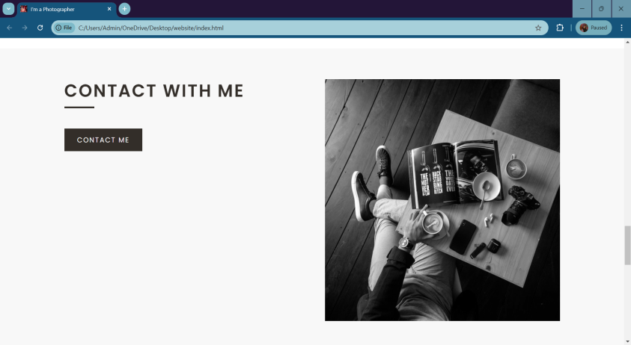
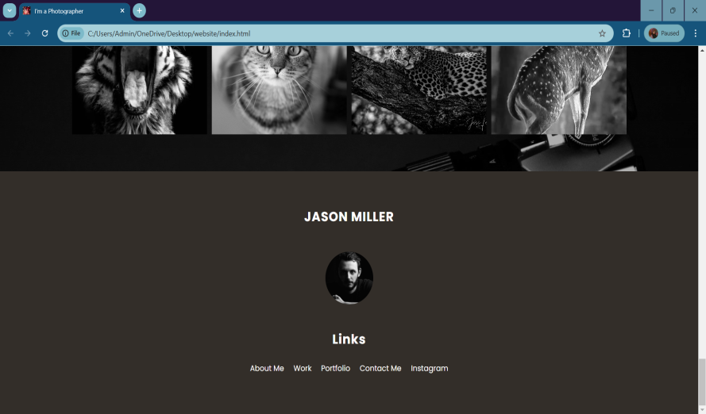
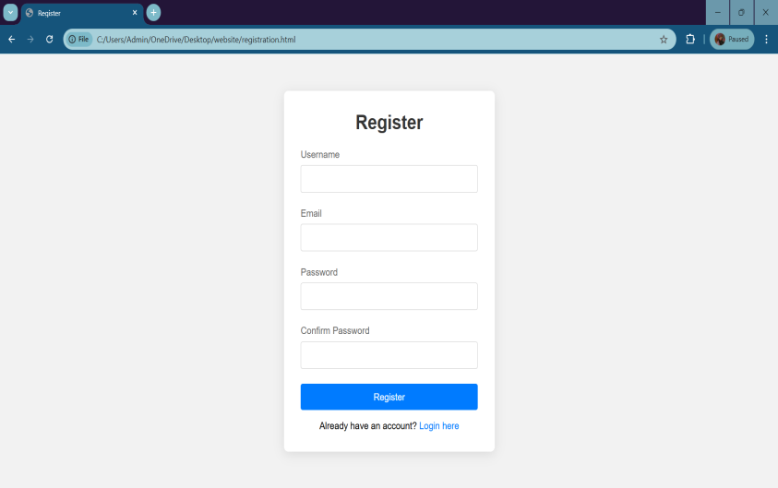
INPUT AND OUTPUT DESINE

Slide 15



THANKS YOU
Contact :-
+91 9730524054
E-MAIL :-
owalunj237@gmail.com
ADDRESS :-
AT-JESUS CHRIST SCHOOL GROUND KAMSHET 410405

